Slide 1
Next ToDo
Analyze the reason why fuzzing stability is too low for some programs
Does the reason is general or specific for each target program?
Analyze the reasons for the instability of cflow and bison
NOTE: after exhaustive global var. reinitialization, persistent mode for bison still fails for all seed inputs
By excluding unstable-but-correct functions (files) from instrumentation
By repeating 1. finds a variable input, 2. finds the GV list to reinit. for the variable input, 3. reinitialize the GVs
Make 100% stability of binutils/nm and exiv2

Slide 2
Brief Conclusion
Found NO reason that the persistent mode itself affects the stability
However, persistent mode makes randomness of a target program easy to occur
Limitations
Fails to analyze many variable edges: found no input reproducing the variable edges
Fails to exclude unstable-but-correct functions

Slide 3
Procedure for Improving Stability
Repeatedly improve GV list to reinitialize
Make a list of
Global Variables (GV)
Exhaustive Reinitialization
GV list
For each GV in the list
Run gdb
Target program
A seed input
Extract the value
of the GV at the beginning
Extract the value
of the GV at the end
GV value
at the beginning
GV value
at the end
If an input changes,
GV list to reinitialize also changes.
If they are different,
GV list to reinitialize
GV

Slide 4
Procedure for Improving Stability
Seed inputs
Pre-run: afl-fuzz
with debug mode
Variable (var.) edges
obtained by afl-fuzz
var. edges
ignored
Add the var. edges
difference
target
program
var. inputs
obtained by afl-fuzz
If a new GV to reinit found,
GV list to reinit
var. edges
Add the found GV
For each input
Exhaustive Reinitialization
afl-fuzz
with debug mode
For each input
(real) var. inputs
with var. edges
Advanced Exhaustive Reinitialization

Slide 5
Procedure for Improving Stability
Pre-run for 1000~5000 inputs
Run afl-fuzz for each var. input 8 times
Can catch var. edges only if it occur until the eight runs
Repeat the procedure until the procedure cannot find a new GV to reinit

Slide 6

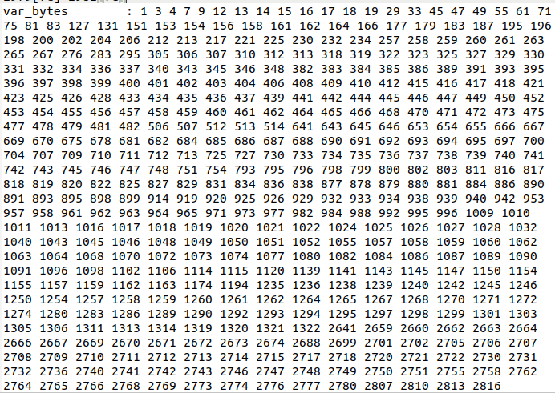
During the Procedure
Only find the implicit randomness affecting the stability
e.g, Hash function using memory addresses as the key value, masking function to memory addresses
Add them to the var. edges ignored
Still there are many var. edges that cannot be reproduced
Masking using a bit operation for a memory address obtained by a dynamic mem allocation
fails to reproduce
ignored

Slide 7
Results
Improved speed, stability, and crash detection ability of advanced exhaustive reinitialization
Compared to exhaustive reinitialization
cflow-1.6 | exec/sec | bitmap_cvg | stability | saved crashes (reproducible)
Normal | 2437.59 | 21.58% | 100.00% | 189
PM | 10985.00 | 22.54% | 21.94% | 207 (199)
PM (ExReinit) | 3703.74 | 22.55% | 31.79% | 183 (179)
PM (Adv.ExRinit) | 4212.03 | 22.11% | 38.32% | 215 (213)
188 known crashes and 1 new crash
All the known crashes
All the known crashes
212 known crashes and 1 new crash
(different from the one normal found)

Slide 8
Limitation about the unstable-but-correct functions
Excluding the functions from the instrumentation
Inputs finding the edges from the functions are not identified as interesting
LLVM 12+ necessary but, using afl-clang-lto with LLVM (clang) 13 fails to build cflow

